Slide 1
Exploratory Data Analysis (EDA) - School Dataset
Unveiling insights into student performance, fees, and demographics

Slide 2
Introduction: Understanding the Dataset
This analysis aims to uncover key insights about students, schools, and academic performance.
We will explore:
- Student demographics and income levels
- Distribution of marks and academic performance
- The relationship between school fees, family income, and performance
- Patterns and trends for better decision-making

Slide 3
Dataset Overview: Key Numbers
- Total Students: 800
- Number of Schools: 3
- Classes Represented: 12
- Age Range: 5 - 20
- Marks Range: 55 - 500
- Average Monthly Family Income: 24,664.21
- Average Monthly School Fees: 2,853.75

Slide 4
Data Cleaning Process
To ensure data quality, the following cleaning steps were performed:
1. Handling Missing Values: Checked for missing or null values and addressed them appropriately.
2. Removing Duplicates: Ensured each student and school record is unique.
3. Correcting Data Types: Converted numerical and categorical variables correctly.
4. Outlier Detection: Identified and treated extreme values in marks, fees, and income.

Slide 5
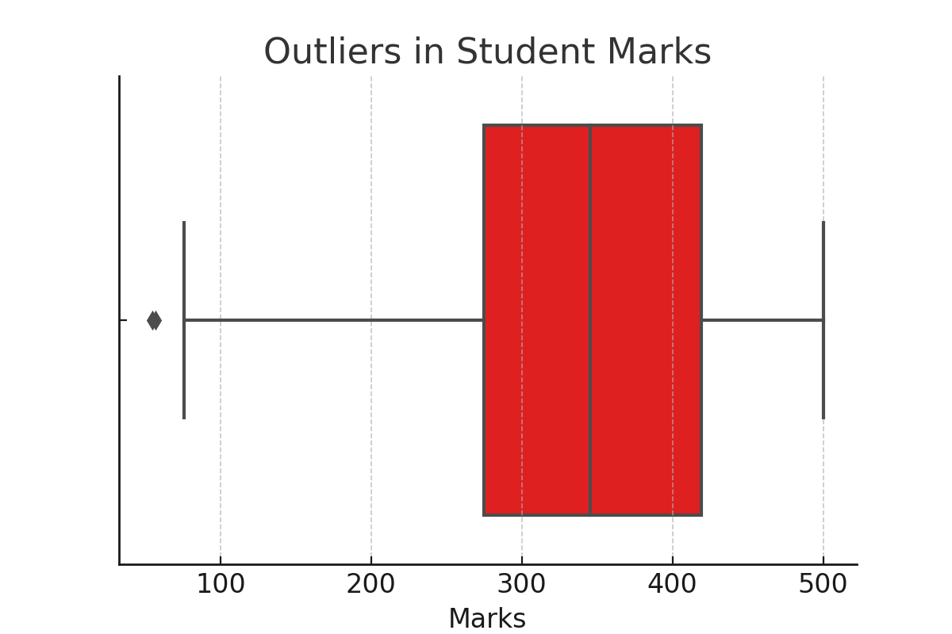
Outlier Detection in Student Marks
Boxplot showing extreme values in student marks.
There are total 2 students who have every extremely low marks compared to overall marks.

Slide 6
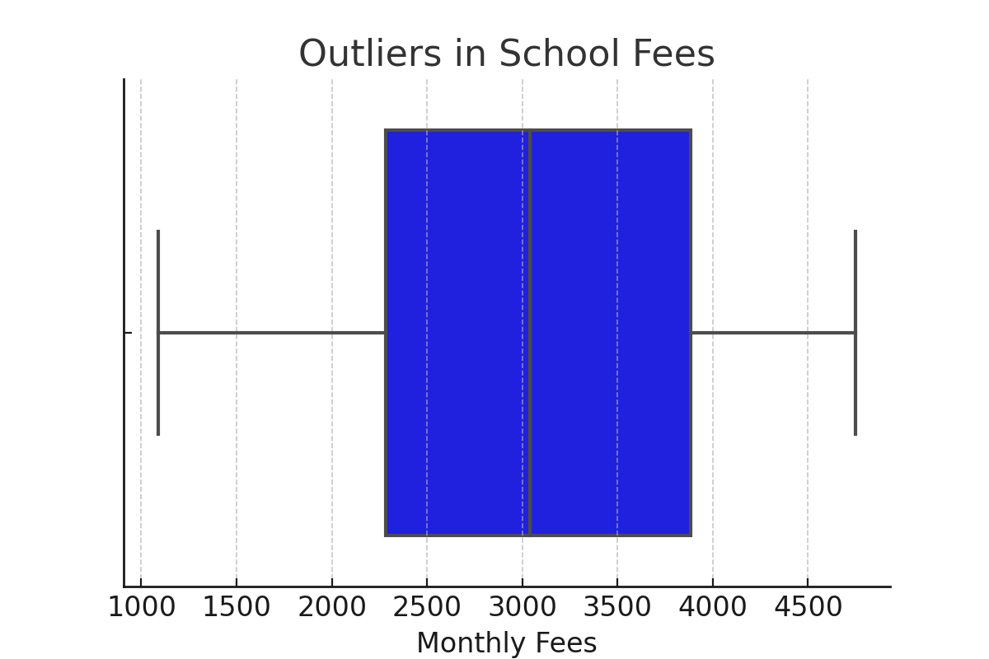
Outlier Detection in School Fees
Boxplot showing extreme values in school fees.

Slide 7
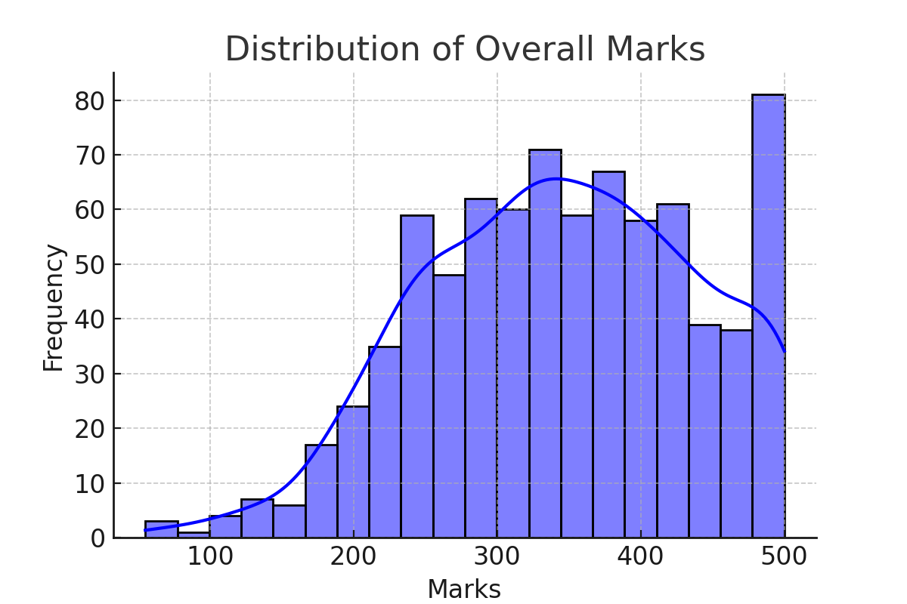
How Do Students Perform?
The distribution of student marks gives insights into overall performance.
Class 5 has the highest average marks (375.24),
while Class 9 has the lowest average marks (322.4).

Slide 8
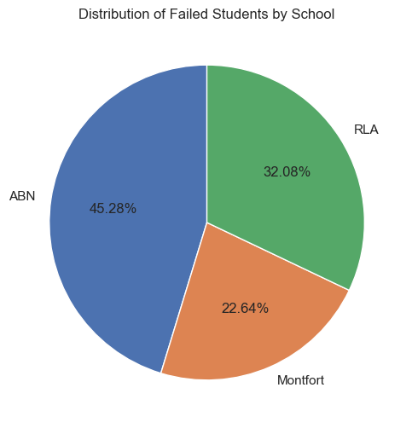
Failure Rate: Who Needs More Support?
Percentage of students who scored below 200 passing marks from all the schools : 6.62%
Class 2 has the highest failure rate, with 10% of students scoring below the passing marks.

Slide 9
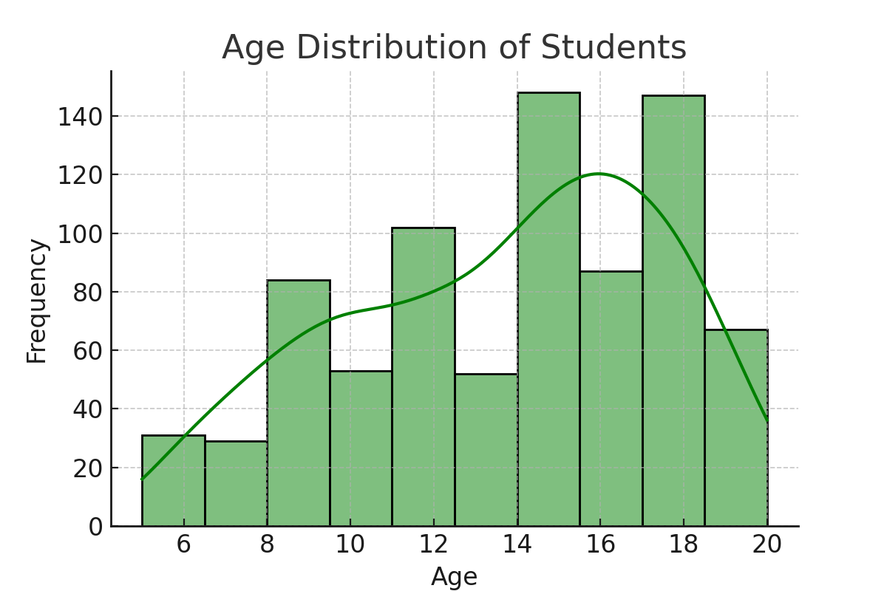
How Old Are the Students?
Understanding the age distribution across schools.

Slide 10
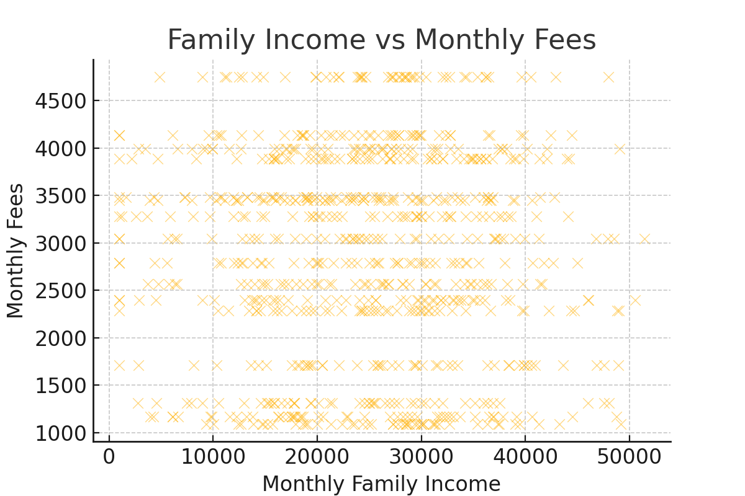
Can Families Afford School Fees?
Exploring the relationship between family income and school fees.
Approximately 19% of students cannot afford their school fees, as their fees exceed 20% of their monthly family income.

Slide 11
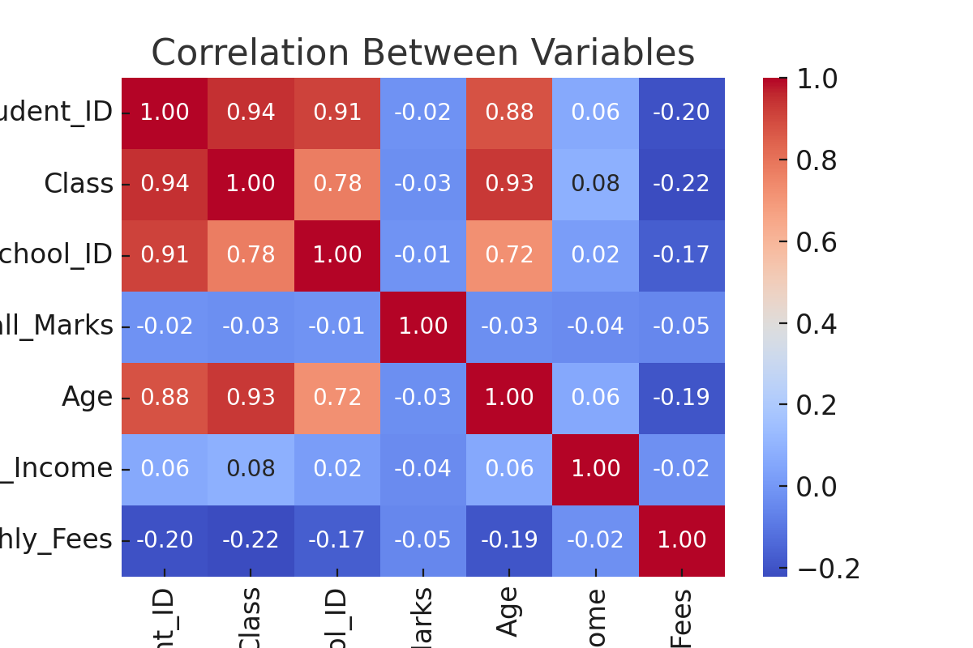
What Factors Influence Performance?
Correlation analysis between fees, marks, and family income.
Weak Correlation Between Fees and Marks (-0.05)
Negligible Correlation Between Family Income and Marks (-0.039)
Almost No Correlation Between Fees and Family Income (-0.022)

Slide 12
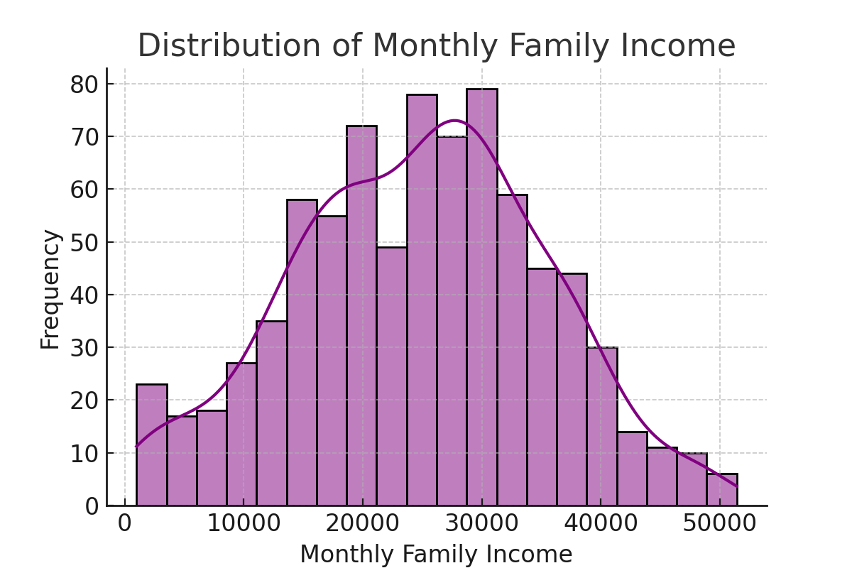
Income Levels of Families
Histogram showing the distribution of family incomes.
Approximately 9% of families have a monthly income of less than 10,000.

Slide 13
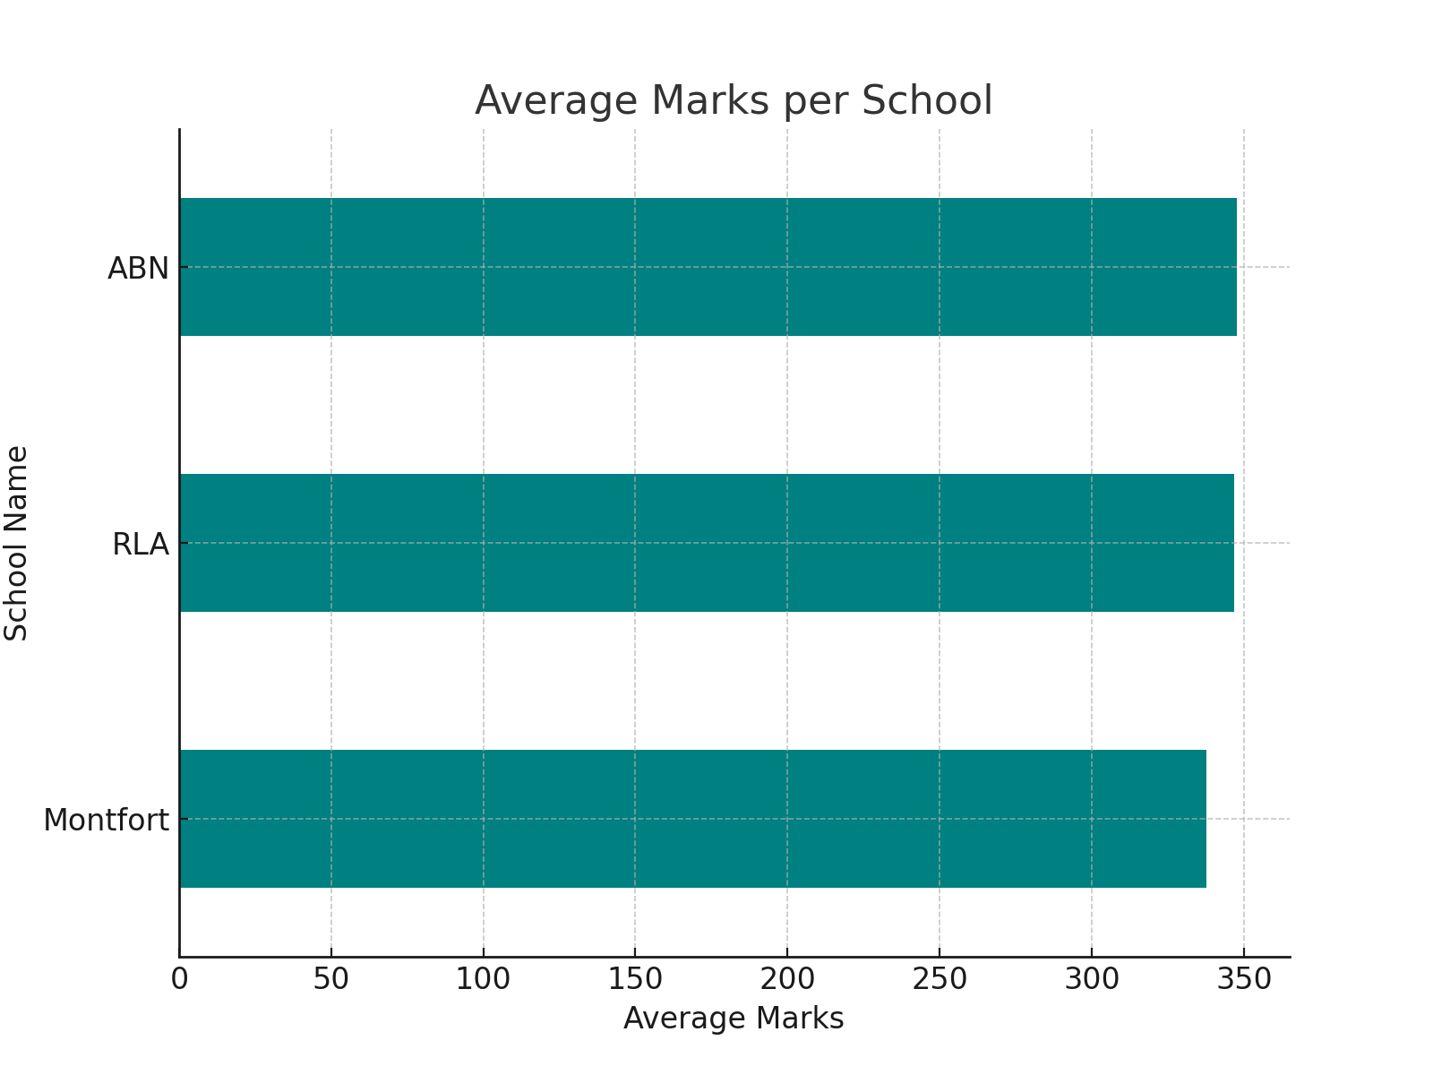
Which Schools Perform Best?
Bar chart showing the average marks per school.

Slide 14
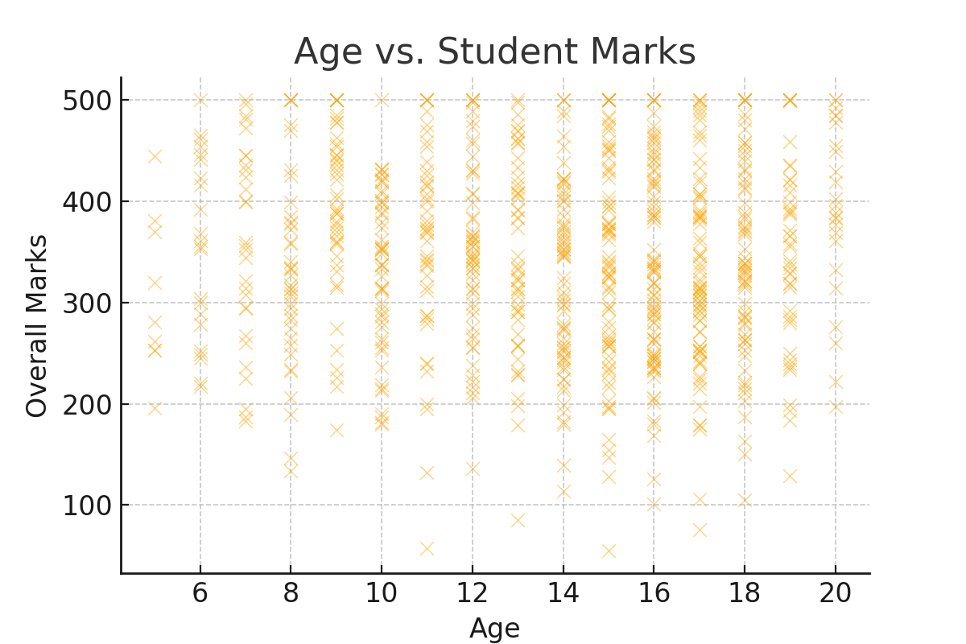
Does Age Affect Performance?
Scatter plot showing the relationship between age and student marks.
The correlation between Age and Overall Marks is -0.026, indicating an almost negligible relationship.

Slide 15
After understanding the data
1. Data-Driven Decision Making:
Schools can utilize this analysis to optimize resource allocation, improve student performance, and design targeted interventions.
2. Financial Insights for Policy Makers:
The correlation between family income and school fees highlights the need for structured financial aid programs.

Slide 16
Final Suggestions for Improvement in students
1. Implementing Need-Based Scholarships: Schools should introduce financial aid programs to support students from lower-income backgrounds.
2. Enhancing Learning Support: Schools should identify students at risk of failure early and provide additional academic resources.

Slide 17
Conclusion
Key Findings:
- A significant percentage of students scored below the passing mark.
- Family income does little influence on the type of school students attend.
- Higher school fees not strongly linked to better academic performance.

